Slide 1
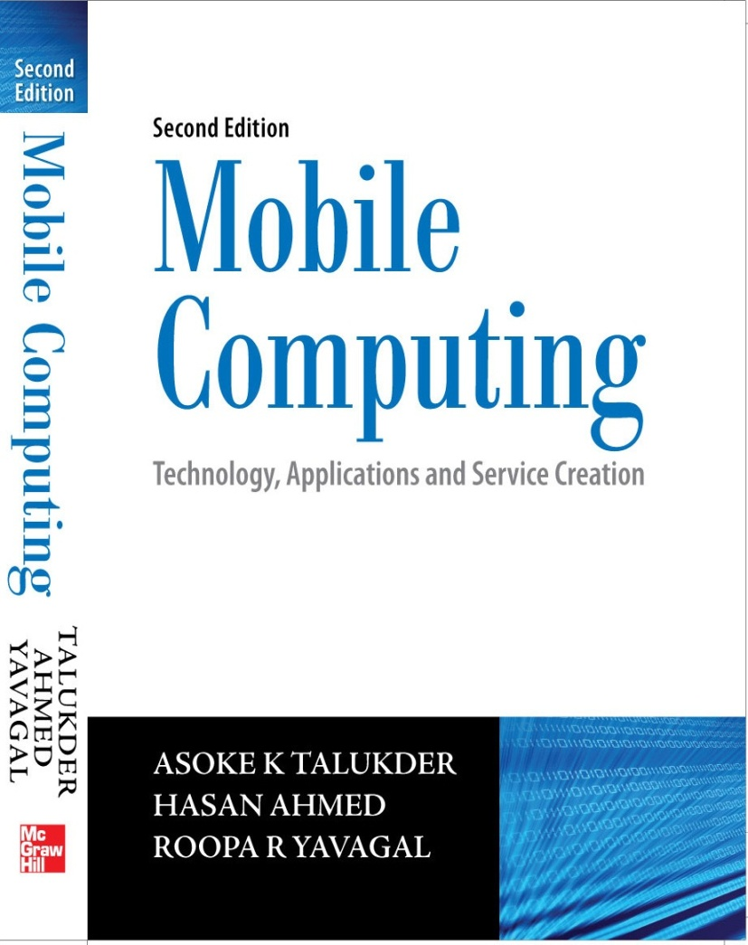
Notes#3
Mobile Computing Through Telephony

Slide 2
Evolution of Telephony
1876 – First telephone system by Alexander Graham Bell
1892 – Strowger switch installed as first automatic telephone exchange
1960 – Electronic Switching System (ESS) developed by AT&T
1962 – Carrier system went digital
1960’s and 1970’s – Stored program telephone exchanges
1980’s – Wireless telephony emerged
1990’s – Mobile telephony flourished commercially across the world

Slide 3
Public Switched Telephone Network
Three categories of nodes – local exchanges, transit exchanges, and international exchanges.
Local exchanges are used for subscriber connection.
Transit exchanges switch traffic within and between different geographical areas.
International exchanges switch traffic to telecommunication networks in foreign countries and other distant networks.
Last mile – a physical wire (also known as local loop) that is laid from local exchange to the device at subscriber premises.
Last mile is absent in case of GSM.

Slide 4
Multiple Access Procedures
We need to control simultaneous access of radio channel in order to avoid collisions.
In a connection oriented communication, collisions are undesirable.
For effective utilization, channel has to be utilized intelligently by the use of multiplexing.
Four major types of multiple access procedures are Frequency Division Multiple Access (FDMA), Time Division Multiple Access (TDMA), Code Division Multiple Access (CDMA) and Space Division Multiple Access (SDMA).

Slide 5
Frequency Division Multiple Access
The available frequency band is divided into channels of equal bandwidth so that each communication is carried on a different frequency.
FDMA was used in all the first generation analog mobile networks like TACS in UK and AMPS in USA.

Slide 6
Time Division Multiple Access
It needs precise synchronization between transmitter and receiver.
The whole frequency bandwidth is subdivided into sub – bands using FDMA techniques. TDMA is then used in each of these sub – bands to offer multiple access.
TDMA is more expensive than FDMA.
GSM uses TDMA.

Slide 7
Code Division Multiple Access
CDMA uses spread spectrum technique where each subscriber uses the whole system bandwidth.
In CDMA, all subscribers in a cell use the same frequency band simultaneously.
To separate the signals in CDMA, each subscriber is assigned an orthogonal code called chip.
CDMA is a broadband system.

Slide 8
Space Division Multiple Access
SDMA is a technique where we use different part of the space for multiplexing.
SDMA is used in radio transmission and is more useful in satellite communications to optimize the use of radio spectrum by using directional properties of antennas.
In SDMA, antennas are highly bidirectional while allowing duplicate frequencies to be used at the same time for multiple surface zones on Earth.
SDMA requires careful choice of zones for each transmitter and also requires precise antenna alignment.

Slide 9
Satellite Communication Systems
Every communications satellite involves the transmission of information from an originating ground station to the satellite followed by a retransmission of the information from the satellite back to the ground called the uplink and the downlink respectively. Hence, the satellite must have a receiver with receive antennas, and a transmitter with transmit antennas.
It must also have some methods for connecting the uplink to the downlink for retransmission with amplification; also, it must have electrical power through solar energy to run all of the electronics. The downlink may either be to a select number of ground stations or may be broadcast to everyone over a large area.

Slide 10
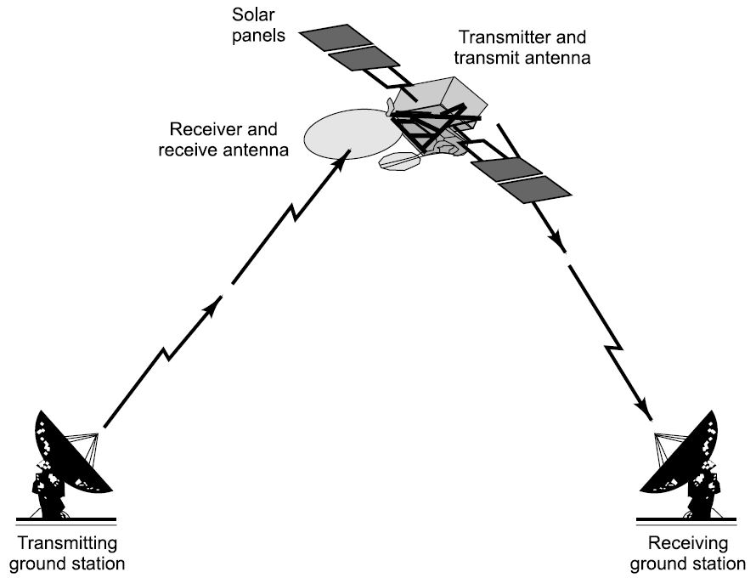
Satellite Communication Systems

Slide 11
Satellite Communication Systems
A properly designed satellite antenna will concentrate most of the transmitter power within a designated area using space division multiplexing.
One of the biggest differences between a low earth satellite and a geosynchronous satellite is in their antennas. All antennas in use today radiate energy preferentially in some direction.
The most important application for communication satellites
was in intercontinental long distance telephony. The fixed Public Switched Telephone Network relays telephone calls from land line telephones to an earth station, where they are then transmitted to a geostationary satellite.
The downlink follows an analogous path.

Slide 12
Low Earth Orbit Satellite
A Low Earth Orbit (LEO) satellite typically orbits around the earth about 400 kilometers above the earth’s surface with a time period of about 90 minutes.
These satellites are only visible from within a radius of roughly 1000 kilometers from the sub-satellite point. Sub-satellite point is the point of intersection of earth’s surface with the straight line from the satellite to the center of earth.
The greatest advantage of LEO satellite is that it does not need high powered rockets—making it less expensive to launch. Also, due to its proximity to the ground, LEO does not require high
signal strength.

Slide 13
Medium Earth Orbit Satellite
A Medium Earth Orbit (MEO), sometimes called Intermediate Circular Orbit (ICO), is the region of space around the earth above low earth orbit of 2,000 kilometres and below geostationary orbit of 35,786 kilometers.
The most common use for satellites in this region is for navigation, such as the GPS (with an altitude of 20,200 kilometers), Communications satellites that cover the North and South Pole are also put in MEO.
The orbital periods of MEO satellites range from about 2 to 24
hours. The MEO orbit has a moderate number of satellites.

Slide 14
Geostationary Earth Orbit Satellite
In geostationary satellite, the orbit of the artificial satellite is such that the orbital speed of the satellite is same as the speed of earth’s rotation. Though the satellite is moving at a high speed, from earth it will always appear to be stationary—this is the reason for calling it geo-stationary.
The GEO satellite could view approximately 42% of the earth. Therefore, a system of three GEO satellites, with the ability to relay messages from one GEO to the other could interconnect virtually all of the earth except the polar regions.

Slide 15
Satellite Phones
Initially satellite communication was being used for broadcast to stationary TV receivers, and transmission of telephone channels.
However, demand on mobile phone made some companies to look into satellite phones that will connect a subscriber directly through the communication satellite, where the satellite will function as the transceiver station connecting the mobile phone.

Slide 16
Satellite Phone Companies
Iridium
Globalstar
Thuraya

Slide 17
Mobile Computing through Telephone
Computer Telephony Interface (CTI) – accessing applications through voice interface
Intelligent Networks (IN) – solving problem of multiple and geographically bounded numbers
CTI achieved through Interactive Voice Response Service (IVRS)
IVRS – known as Voice Response Unit in USA
Audiotex systems – systems based on IVRS and VRU
Dual Tone Multi Frequency (DTMF) – extensively used in IVRS

Slide 18

Architecture for CTI
PSTN (Telephone Network)
Content Server
Voice & DTMF as input
Voice as output

Slide 19
Benefits of CTI
Easy integration with existing telephone and computer systems irrespective of whether they are state – of – the – art databases or legacy systems
Independent of the locale and culture as the same application can be adapted for other languages very quickly
Very effective for rural population and senior citizens who are not computer savvy
Comprehensive voice – processing capabilities designed specifically for small, middle and large – size businesses
Provide customized application development tools that are ideal for different size and types of businesses

Slide 20
How CTI is different?
The only difference is User Interface
Input through Dual Tone Multi Frequency (DTMF) telephone keypad
Input through rotary telephone
Input through voice
Output is always audible sound

Slide 21
Interactive Voice Response Service
IVRS
DATA
Dial 6542222
Pre-recorded voice prompts guide the user
to get the relevant information
User inputs data using the telephone keypad
Enterprise E-mail / Data
Flight related information
Legacy data

Slide 22

Deployment for IVRS
PSTN
Exchange
Application
Mobile
Exchange
IVRS
DATA

Slide 23
Architecture for IVRS
DataBase
Application
IVRS API’S
Remote Monitoring
Dialogic API
Dialogic Hardware
Telecom
Network

Slide 24
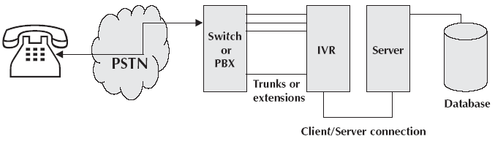
Architecture for IVRS – in general

Slide 25
Dialogic architecture for IVRS
User Application
Other Dialogic Libraries
Global Call API
Call Control Libraries
ANAPI I CAPI PDKRT ISDN DM3CC SS7
Device Drivers
Operating Systems
Network Interface
Network Interface
Firmware
Firmware
Telecom
Network

Slide 26
IVRS enables solutions like …
Text to speech conversion
Voice / music messaging
Inbound and outbound call processing
Audiotex premium rate services
Intelligent call directing and routing
Voice mail
Billing information and fax on demand.
Reminder service

Slide 27
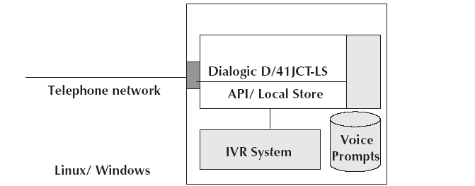
Inside an IVRS

Slide 28
IVRS – Interface to exchange
Physical Interface :
Analog : RJ 11
Digital : 2Mbps E1 interface (75 ohm / 120 ohm)
Digital Signaling :
ISDN-Primary Rate Interface
R2-MFC
SS#7

Slide 29
Features of IVRS – I
Touch tone input (DTMF)
Caller identification detection
Multiple application hosting
DNI based application routing
Out dialing
Call transfer
Audio recording
Text – to – speech conversion

Slide 30
Features of IVRS – II
CDR
GUI based remote monitoring
Call statistics (Web Interface)
Database access
Data access through Internet
Support of standard voice file format (.vox, .wav, etc)

Slide 31
Features of IVRS – III
Input through
- Telephone keypad
- Rotary dial
- Voice recognition
Numeric input (avoid alphabetic input)
- Convert numeric input to other types of input through menu
Alphabetic input can be OK if played back
Output through
- Synthesized voice
- Text – to - speech

Slide 32
Using IVRS through telephone keys
Alphabets A, B and C on key 2
Alphabets C, E and F on key 3
Alphabets G, H and I on key 4
Alphabets J, K and L on key 5
Alphabets M, N and O on key 6
Alphabets P, Q, R and S on key 7
Alphabets T, U and V on key 8
Alphabets W, X, Y and Z on key 9

Slide 33
Using IVRS – DTMF frequencies
 | 1209 Hz | 1336Hz | 1477Hz
697 Hz | 1 | 2/ABC | 3/DEF
770Hz | 4/GHI | 5/JKL | 6/MNO
852 Hz | 7/PQRS | 8/TUV | 9/WXYZ
941 Hz | * | 0 | #

Slide 34
Synthesized Voice
Prerecorded syllables or part of the response recorded into separate files and stored in persistent storage
As and when necessary, these files will be played through programming logic the way we do convert numeric to text in a bank cheque
Example: 123 = one.vox + hundred.vox + twenty.vox + three.vox
where .vox is pre – recorded voice

Slide 35
Voice driver and API’s
Used to communicate and control voice hardware on IVRS system
Can make calls, answer calls, identify caller, play and record sound from phone line and detect DTMF signals
Can tear down a call detect that caller has hung up
Offers API’s to record transaction details

Slide 36
IVRS Programming
Voice libraries are supported by Dialogic to interface with voice driver
Voice libraries exist for single and multithreaded applications
C function libraries exist for a number of purposes
Standard run time library provides a set of common functions independent of device and applicable to Dialogic devices

Slide 37
Single threaded programming model
Enables a program to control multiple voice channels within a single thread
Allows development of applications where multiple tasks need to be coordinated simultaneously
Supports both polled and call back event management

Slide 38
Multithreaded programming model
Uses functions that block application execution until the function completes
Applications control each channel from a separate thread or a process
Enables IVRS system to assign distinct applications to different channels dynamically in real time

Slide 39
Voice API’s
Dialogic provides API’s to use voice board
API’s are available for:
Device management
Configuration functions
I/O functions
Play and record functions
Tone detection and generation functions
Call control functions

Slide 40
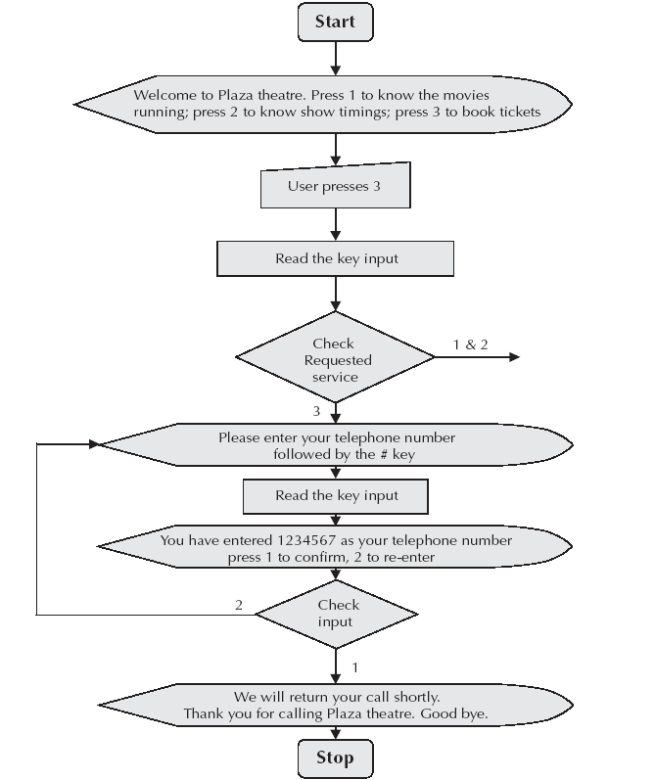
A typical IVRS call flow

Slide 41
IVRS applications – I
Virtual Receptionist:
Having a hard time finding someone to answer the phones and route calls? Active call center can answer and screen your phone calls, take messages, or even route.
Automated Information Retrieval:
Give yourself more time to deal with important issues. Create simple touch tone menus that will allow your customers to retrieve directions, contact information, store hours, special promotions, and more.

Slide 42
IVRS applications – II
Interactive Voice Response with content from databases:
Integrate with your databases and deliver retrieved information back to the caller. For example, a caller might request his order status by entering their order number via touch – tone.
Need to send SMS:
With this revolutionary technology, you can send SMS from your landline phone to any mobile in the world.

Slide 43
IVRS applications – III
Hands free and eyes free communication
Voice messaging and voice enabled infotainment services
Prepaid and calling card call management
Self configuring systems
Flight schedules & status
Voice mail and voice portals
Telebanking
Binary downloads
Songs on request
Telephone directory
Call centres

Slide 44
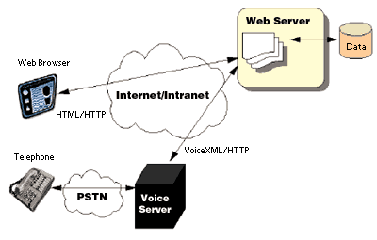
Voice XML

Slide 45
Voice XML
XML based mark up language for creating distributed voice applications
Creates audio dialogs that feature synthesized speech, digitized audio, spoken voice recognition and DTMF key input
Helps creation of web based voice applications that users can access over telephone

Slide 46
Features of Voice XML dialogs
Spoken input
DTMF input
Recording of spoken input
Synthesized speech output
Recorded audio output
Dialog flow control
Scoping of input

Slide 47
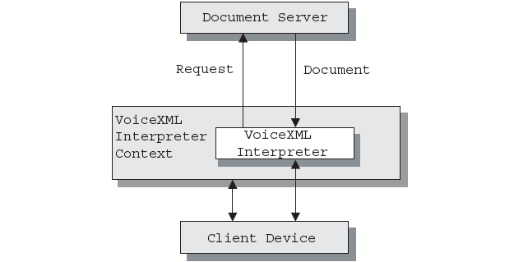
Architecture for Voice XML

Slide 48
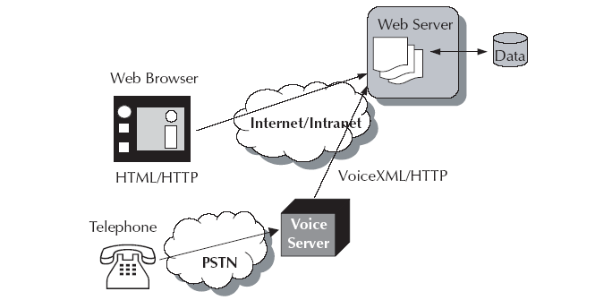
Voice XML in web environment

Slide 49
Voice XML in web environment
Voice server manages several voice browser sessions.
Each voice browser session includes one instance of voice browser, speech recognition engine and text – to – speech engine.
Voice browser renders and interprets Voice XML documents.
Voice and telephone are needed to access web information and services over voice browser.
Voice XML application defines a series of dialogs between user and computer.
The user is always in a dialog at any time and each dialog determines the next dialog to transition to.
Transitions are specified using URI’s.

Slide 50
Essentials of Voice XML
First line will always contain <?xml> element.
Second line will always contain <vxml> element.
Every Voice XML tag <tag> must have a associated </tag>.
Last line should contain </vxml>.
Prompts, grammar, form, events and links are building elements of a Voice XML document.

Slide 51
Prompts in Voice XML
Information is presented through audio prompts.
Prompts can be either pre – recorded audio or synthesized speech.
<prompt> is used to generate TTS.
Any text within body of prompt element is spoken.
The software shall read out “Would you like coffee, tea, milk or nothing?” in
<prompt> Would you like coffee, tea, milk or nothing </prompt>

Slide 52
Grammar in Voice XML
Every dialog has one or more speech or DTMF grammars associated with it.
<grammar> is used to define what the caller can say to the application at any given time.
Three types of grammar are supported: Inline, External and Built – in.
Inline grammars are defined right in the Voice XML document.
External grammars are specified in another file and referenced from within Voice XML document code.
Built – in grammars are pre – specified grammars.

Slide 53
Forms in Voice XML
Forms are a way of developing dialog with the caller.
A Voice XML form is a process to present information and gather input from the caller.
A Voice XML form is a collection of one or more fields that the caller fills in by saying something.
Fields tell the caller what to say and define words and phrases that the caller can say.
Based on the caller’s input, the application takes an appropriate action.

Slide 54
Events in Voice XML
Events is Voice XML is a mechanism to handle situations thrown by the platform under a variety of circumstances such as when the user does not respond, requests help, etc.

Slide 55
Links in Voice XML
Links support a mixed initiative.
It specifies a grammar that is active whenever the user is in the scope of the link. If user input matches the link’s grammar, control transfers to link’s destination URI.
Links can be used to throw an event to go to a destination URI.

Slide 56
Example of Voice XML document
<?xml version="1.0"?>
<vxml version="1.0">
<form id="add_funds">
<field name="amount" type="currency">
<prompt>How much?</prompt>
</field>
<field>
<prompt>Charge to credit card or tuition bill?</prompt>
<grammar> credit card | credit | tuition | tuition bill</grammar>
</field>
</form>
</vxml>

Slide 57
JSpeech Markup Language (JSML)
JSML defines a specific set of elements to mark up text to be spoken, and defines the interpretation of those elements so that there is a common understanding between synthesizers and documents producers of how marked up text will be spoken.
JSML elements provide a speech synthesizer with detailed information on how to 'speak' text and thus, enables improvements in the quality, naturalness and understandability of synthesized speech output.
JSML defines elements that describe the structure of a document, provide pronunciations of words and phrases, indicate phrasing, emphasis, pitch and speaking rate, and control other important speech characteristics.
JSML is designed to be simple to learn and use, to be portable across different synthesizers and computing platforms, and to be applicable to a wide range of languages.

Slide 58
Telephony Application Programming Interface
In Telephony Application Programming Interface (TAPI), a developer can develop voice based services without going too deep into it.
Speech Application Programming Interface (SAPI) is also one such standard.
The use of available API’s of TAPI and SAPI shall save the programmer of the pain of trying to program hardware directly.
TAPI includes interface for convergence of both traditional PSTN and IP telephony.

Slide 59
Benefits of TAPI
Simple user interfaces to set up calls
GUI to set up conference call
See whom you are talking to
Make voice attachments with electronic mails
Users can hear voice attachments when reading mails
Send and receive faxes
Set and configure group and security measures

Slide 60
Next Topic
Emerging Technologies

